Slide 1
Autism Spectrum Disorder (ASD):
Why it’s a Spectrum and Gender Differences
Florida State University
Center for Autism and Related Disabilities

Slide 2

FSU CARD
No endorsements are implied in this lecture.
All images have been credited or obtained with proper licensing.

Slide 3
FSU CARD
In accordance with section 1004.55, Florida Statutes (F.S.), and Rule 6A-7.0335, Florida Administrative Code (F.A.C.), Florida State University (FSU) and the Center for Autism and Related Disabilities (CARD) provide nonresidential resource and training services for persons of all ages and levels of intellectual functioning with a documented diagnosis of autism, a pervasive developmental disorder not otherwise specified, an autistic-like disability, a dual sensory impairment or a sensory impairment with other disabling conditions. Services are coordinated with local and state agencies and school districts in an effort not to duplicate services.
Notes:
In accordance with section 1004.55, Florida Statutes (F.S.), and Rule 6A-7.0335, Florida Administrative Code (F.A.C.), Florida State University (FSU) and the Center for Autism and Related Disabilities (CARD) provided nonresidential resource and training services for persons of all ages and levels of intellectual functioning with a documented diagnosis of autism, a pervasive developmental disorder not otherwise specified, an autistic-like disability, a dual sensory impairment or a sensory impairment with other disabling conditions. Services are coordinated with local and state agencies and school districts in an effort not to duplicate services.

Slide 4
Who is FSU CARD

Slide 5
What is CARD’s mission?
FSU CARD provides individuals with autism or related disabilities, their families, and professionals who work with them free consultation, resources, and educational support to build knowledge, confidence, infrastructure, and sustainability within the community.
Notes:
The mission of FSU CARD as cited on fsucard.com.

Slide 6
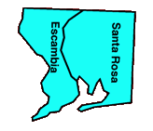
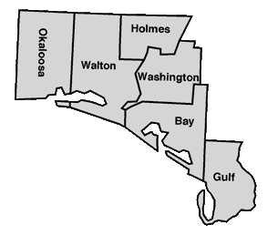
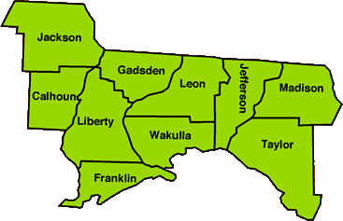
Florida State University
Center for Autism and Related Disabilities
Pensacola
Panama City
Pensacola
Panama City
Tallahassee
Image and information courtesy FSU CARD
Notes:
FSU CARD catchment area
Fsucard.com
Image and information courtesy FSU CARD

Slide 7
What Is CARD?
Center for Autism and Related Disabilities
State funded program through DOE
Free of charge
“Train the Trainer” model
A service provider to enhance existing programs and or services
Capacity builder
Via FSU CARD
Image Description: Map
Notes:
Fsucard.com

Slide 8
Who do we serve?
  Our services are also available to families, professionals, and other community members who are involved with our clients
  We support constituents in different environments without duplicating services
    Family
    School districts
    Other agencies
    Community
Notes:
Who and where our services can be utilized.
Fsucard.com

Slide 9
What is Autism Spectrum Disorder

Slide 10
What is Autism Spectrum Disorder (ASD)?
Autism Spectrum Disorder (DSM-5, 2013) is a complex neurologically-based developmental disability, not a mental health disability.
Individuals with ASD who were diagnosed before 2013 may identify with other labels, such as:
  Autistic Disorder
  Asperger’s Disorder
  Pervasive Developmental Disorder-Not Otherwise Specified (PDD-NOS)
ASD can cause significant social, communication, and behavioral challenges.
  Life-long
  No confirmed cause
  No known cure
  Affects all racial ethnic and social classes
  Via U.S. CDC and American Psychiatric Association
Notes:
American Psychiatric Association. Diagnostic and statistical manual of mental disorders. 5th ed. Arlington, VA: American Psychiatric Association; 2013.
https://www.cdc.gov/ncbddd/autism/hcp-dsm.html

Slide 11
Breakdown of ASD Statistics
1 in 31 Diagnosed with ASD
4:1 ratio of males to females
Via CDC
Notes:
Center for Disease Control (CDC) – 2014
Per current 2022 statistics from the CDC.
https://www.cdc.gov/ncbddd/autism/data.html

Slide 12
DSM-5 Features of ASD
Deficits in social communication and social interaction
(all 3 listed identifiers)
Restricted, repetitive patterns of behavior, interests or activities
  (at least 2 of 4 listed identifiers)
ASD
Via American Psychiatric Association
Notes:
Individuals must meet all three identifiers/criteria listed in the DSM-5 for Section A.
In addition to Section A, all individuals must meet at least meet two out of the four identifiers/criteria listed in the DSM-5 for Section B.
Meeting all four criteria from Section A AND at least two of the four criteria from Section B will help determine a diagnosis of ASD.
American Psychiatric Association. Diagnostic and statistical manual of mental disorders. 5th ed. Arlington, VA: American Psychiatric Association; 2013.

Slide 13
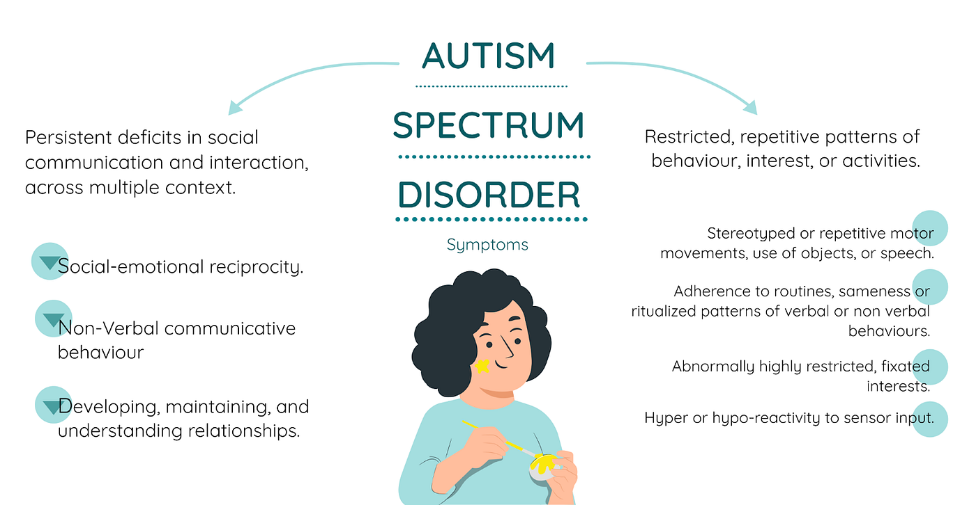
Core Features
Image courtesy of Medium

Slide 14
Why is Autism a Spectrum
“If you’ve met one person with autism, you’ve met one person with autism”
-Dr. Stephen Shore

Slide 15
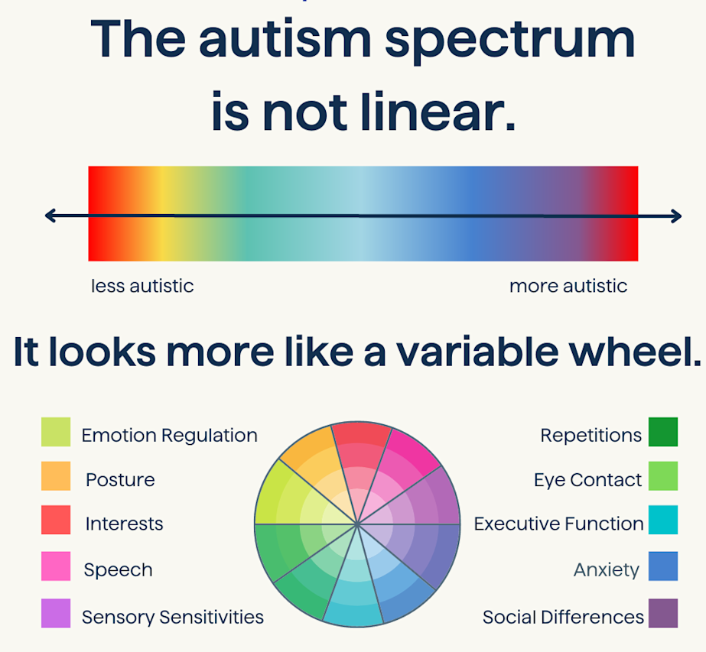
Why is it a Spectrum?
Autism manifests in a wide range of ways:
The "spectrum" highlights the diversity within autism, rather than a single, fixed condition.
Each exhibits unique combinations of characteristics, strengths, and challenges.
  These combinations can be a mix of strengths and challenges
Image courtesy of Cortica

Slide 16
Challenge
Social Abilities
Strength
Changes in Routine
Sensory Issues
Expressive Language
Emotional Regulation

Slide 17
Gender Differences in Autism

Slide 18

Medical Model Gender Differences
Historical
  Medical research and data has been male focused
Affected by:
  Biological factors
  Social biases
  Healthcare practices
Gender bias
  Social roles, gender norms, cultural expectations
  Delayed diagnosis
  Undertreatment
  Negative health outcomes
Image Courtesy Health Europa
Via National Institutes of Health

Slide 19
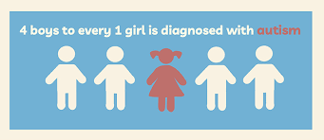
Males
Females
More social challenges
Prefers solitary activity
Earlier diagnosis
External behaviors
Less expressive
Display more aggressive behaviors
Masking and camouflaging
Desire to fit in
Delayed diagnosis
Internalize emotions
Expressive language strengths
Greater anxiety, depression, and eating disorders
Image courtesy Frontiers for Young Minds

Slide 20
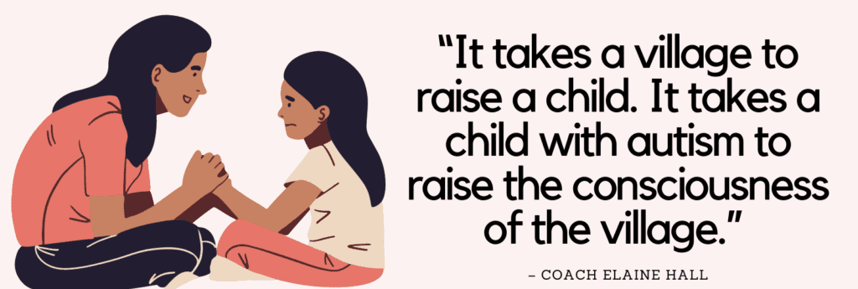
In Closing

Slide 21
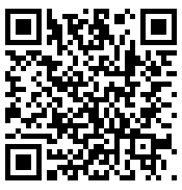
Thank you!
Please complete a brief survey
https://fsu.qualtrics.com/jfe/form/SV_3WcXIOCGpHl5b5s

Slide 22
FSU CARD
2312 Killearn Center Blvd., Bldg. A
Tallahassee, Fl. 32309
Toll Free 800.769.7926
Fax 850.644.3644
http://fsucard.com

